Slide 1
Heterogeneity-aware Twitter Bot Detection with Relational Graph Transformers
AAAI 2022
Code: https://github.com/BunsenFeng/BotHeterogeneity
Reported by Nengqiang Xiang

Slide 2
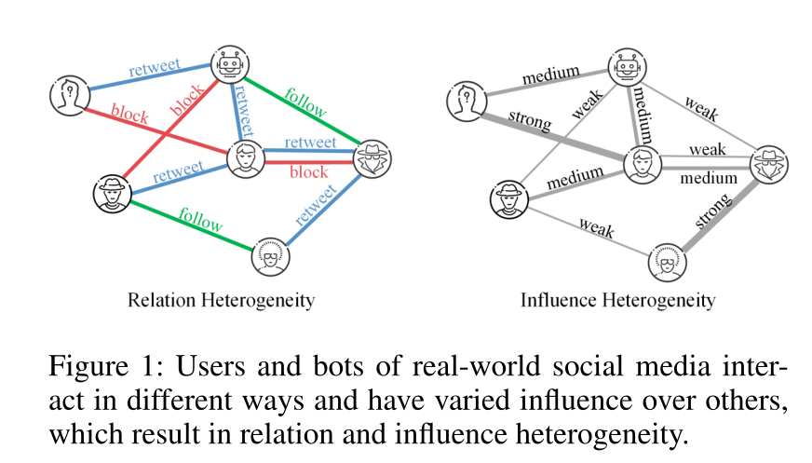
Introduction
State-of-the-art approaches generally leverage the topological structure of the Twittersphere while they neglect the heterogeneity of relations and influence among users.
In this paper, we propose a novel bot detection framework to alleviate this problem, which leverages the topological structure of user-formed heterogeneous graphs and models varying influence intensity between users.

Slide 3
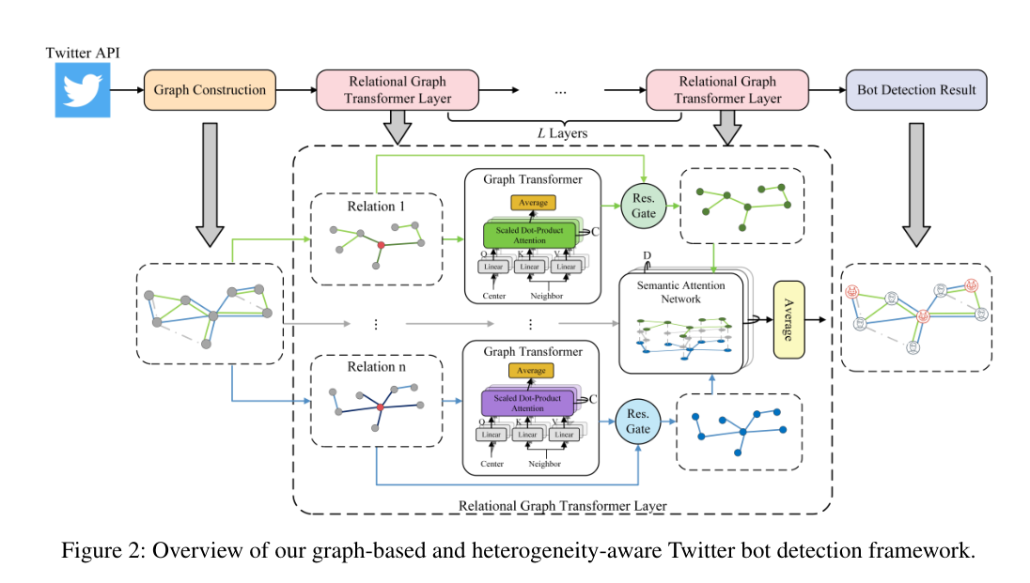
Method

Slide 4
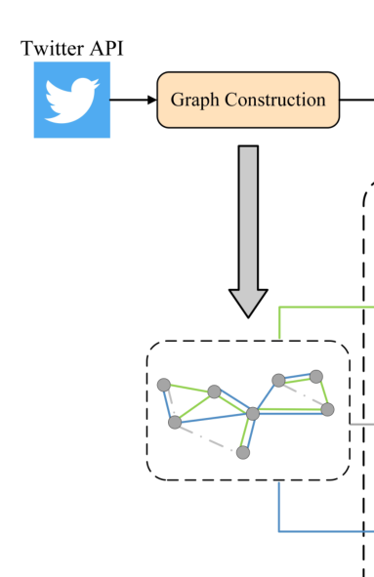
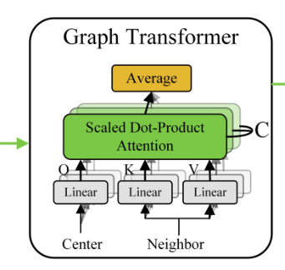
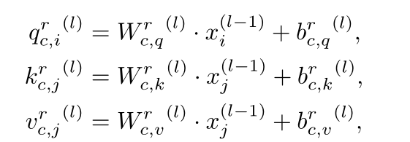
Method
Graph Construction：
（1）
Relational Graph Transformers：
（2）

Slide 5
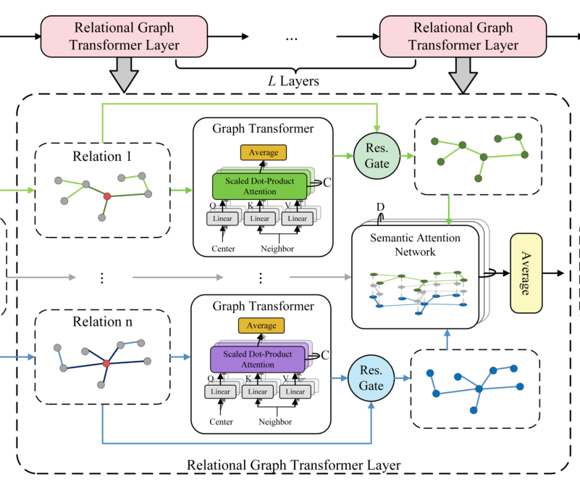
Method
（3）
（4）
（5）
（6）

Slide 6
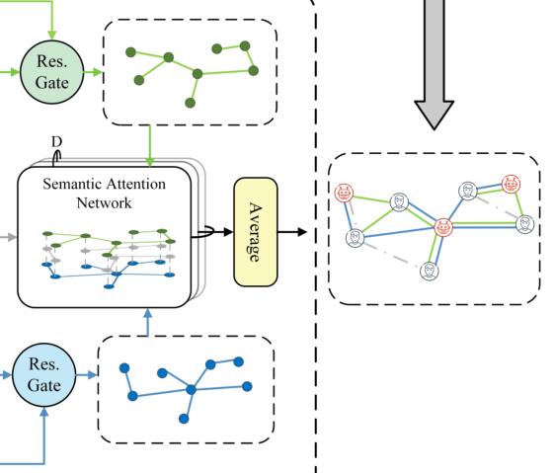
Method
Semantic Attention Networks：
（7）
（8）
（9）
Learning and Optimization：
（10）
（11）

Slide 7
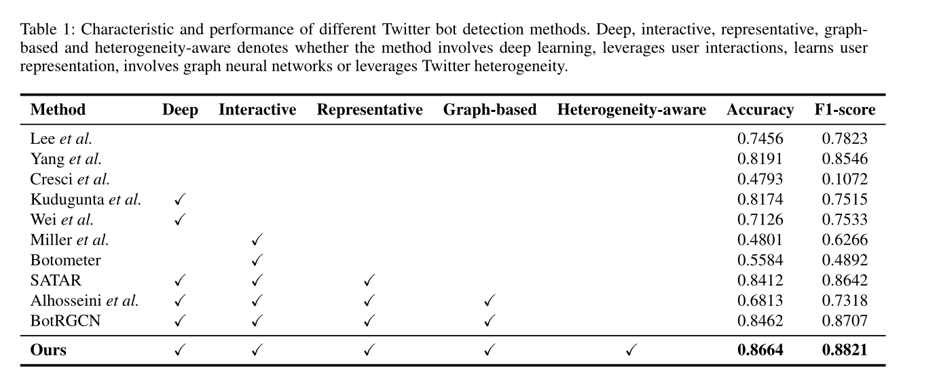
Experiments

Slide 8
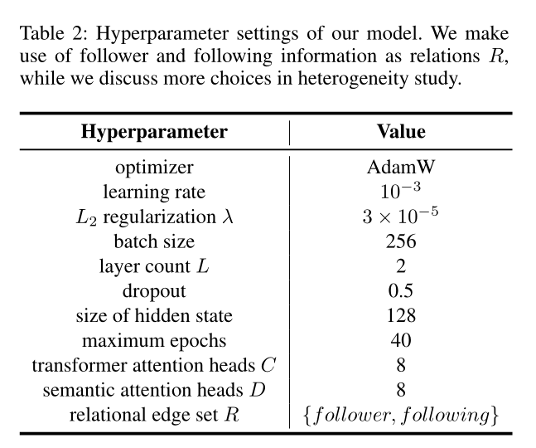
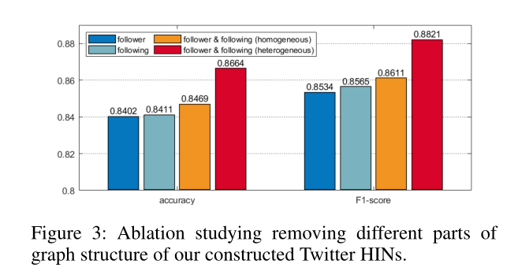
Experiments

Slide 9
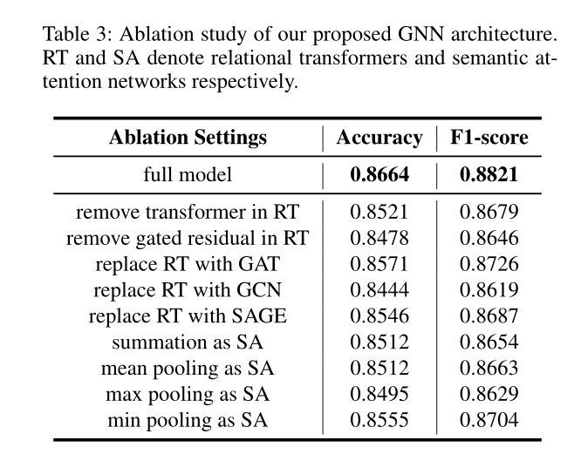
Experiments

Slide 10
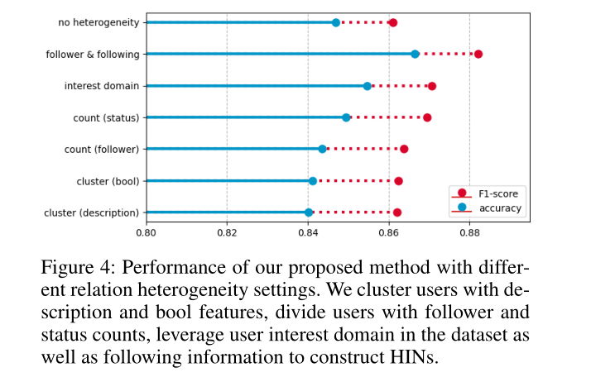
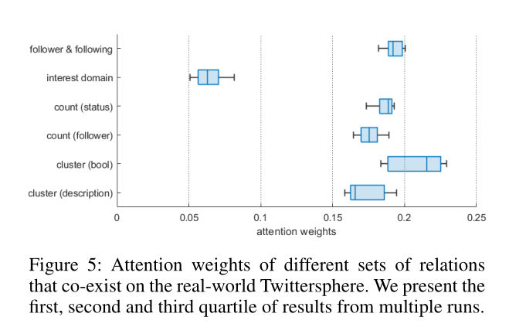
Experiments

Slide 11
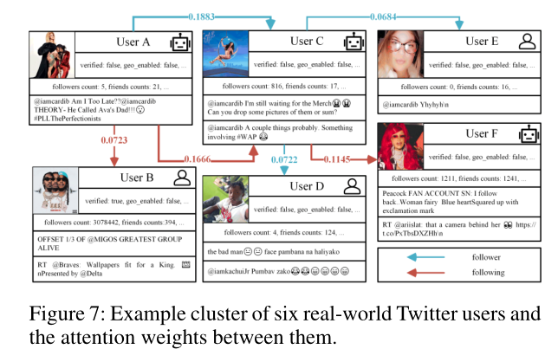
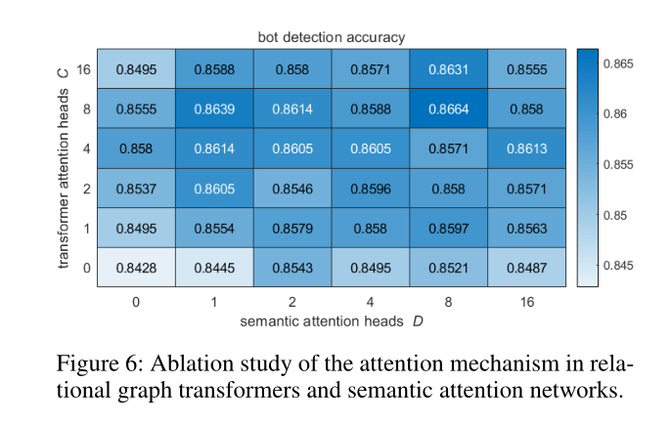
Experiments

Slide 12
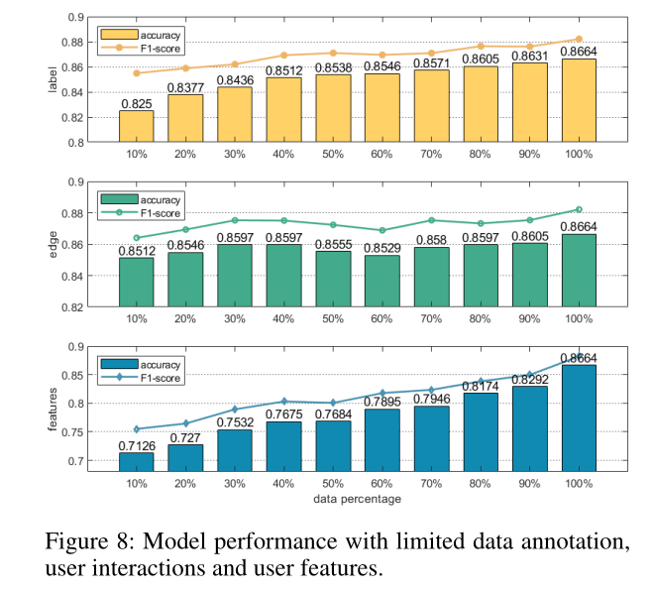
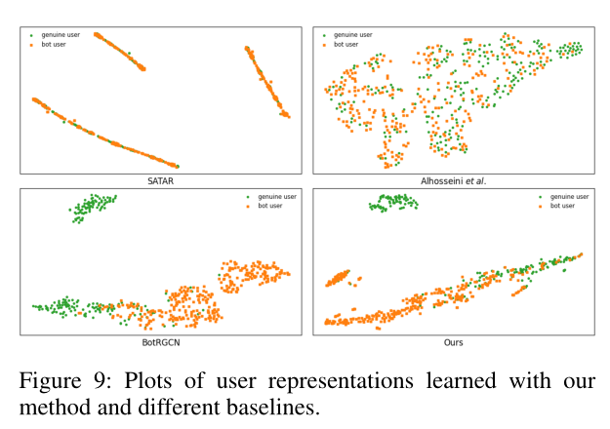
Experiments

Slide 13
Thanks

